Slide 1
Sentinel task management system
Project presentation

Slide 2
Introduction
A task management system is a digital solution designed to help individuals and teams efficiently manage their tasks, projects, and deadlines. In an era where multitasking and juggling numerous responsibilities have become the norm, these systems provide a structured approach to organizing, prioritizing, and tracking tasks.
At its core, a task management system offers features such as:
Task Organization: Categorize and organize tasks based on projects, priorities, or deadlines.
Deadline Management: Set and track due dates to ensure timely completion of tasks.
Progress Monitoring: Track the progress of tasks and projects in real-time.
Collaboration Tools: Facilitate seamless communication and collaboration among team members.

Slide 3
PURPOSE
The primary purpose of a task management system is to provide individuals and teams with a structured and efficient way to manage tasks and projects. By leveraging the features and capabilities of a task management system, users can achieve the following:
Organization: Help users categorize and prioritize tasks, ensuring that important deadlines and responsibilities are not overlooked.
Efficiency: Streamline task execution by providing tools to set deadlines, assign tasks, and monitor progress.
Collaboration: Facilitate seamless communication and collaboration among team members, promoting teamwork and coordination.
Productivity: Enhance overall productivity by reducing time spent on manual task tracking and allowing users to focus on critical tasks.
Accountability: Provide transparency and accountability by tracking task progress and completion, ensuring that everyone stays on the same page.

Slide 4
ER diagram
Status
Name
Name
Pid
T_P
T_Si
Status
Have
1
T_Sn
Project
Issue Date
1
m
m
T_S
Description
Task
Display
T_R
Assigns
m
Tid
Deadline
details
Password
1
Assigned
To
Image
Admin
Email
m
Manages
Uid
Fname
Name
Id
1
m
Lname
Image
User
Email
Gender
Password
Notes:
Check database for changes

Slide 5
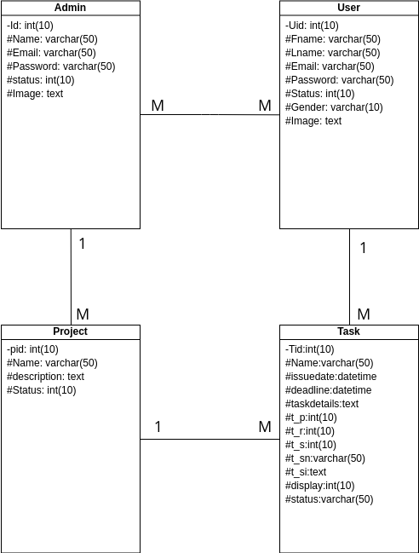
CLASS diagram
Notes:
Check changes from er diagram

Slide 6
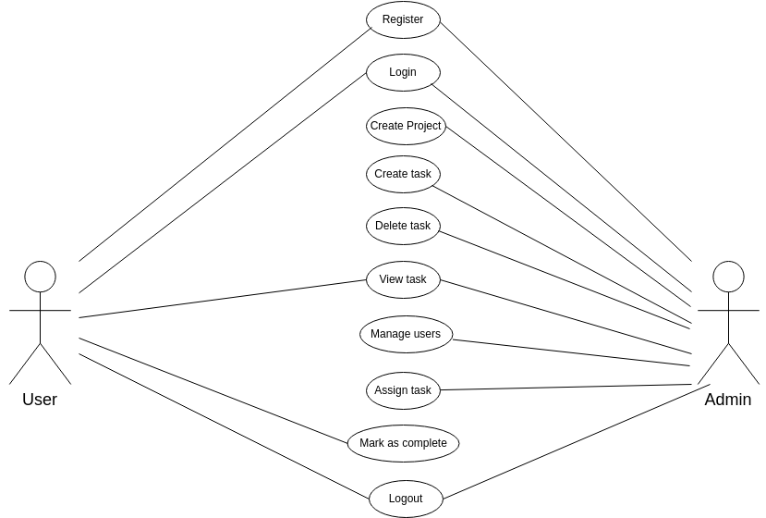
USE CASE diagram
Notes:
Add line betn registration and admin

Slide 7
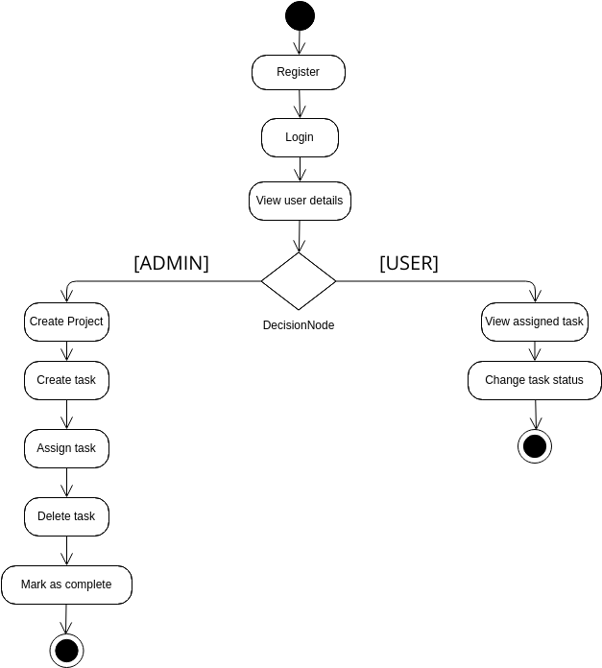
Activity diagram
Notes:
ALL CORRECT

Slide 8
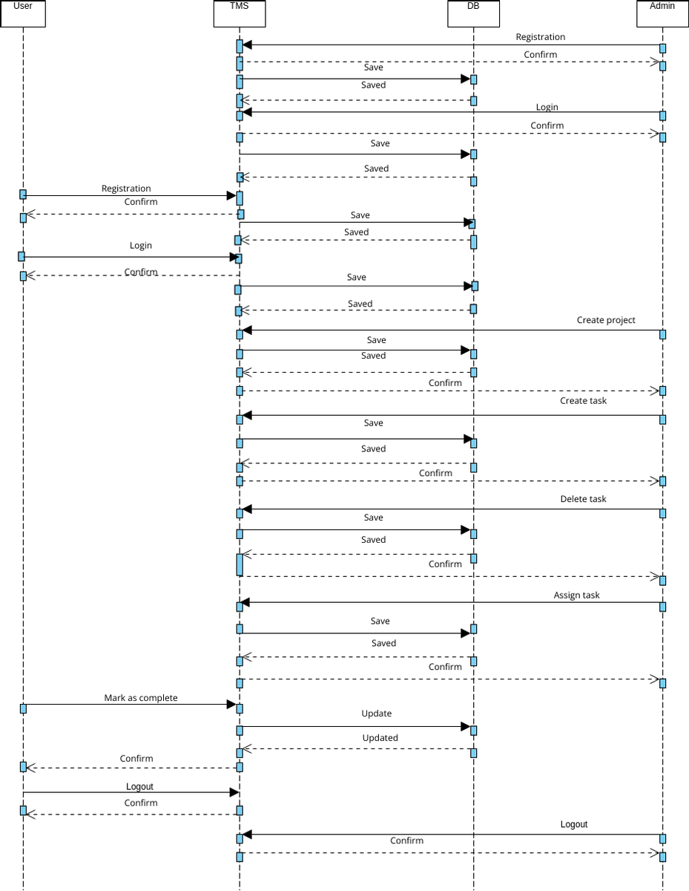
Sequence diagram

Slide 9
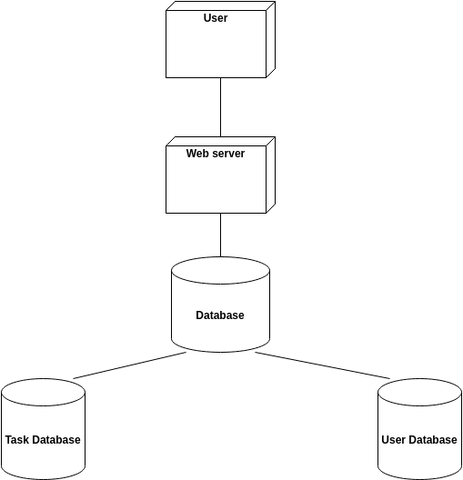
Deployment diagram

Slide 10
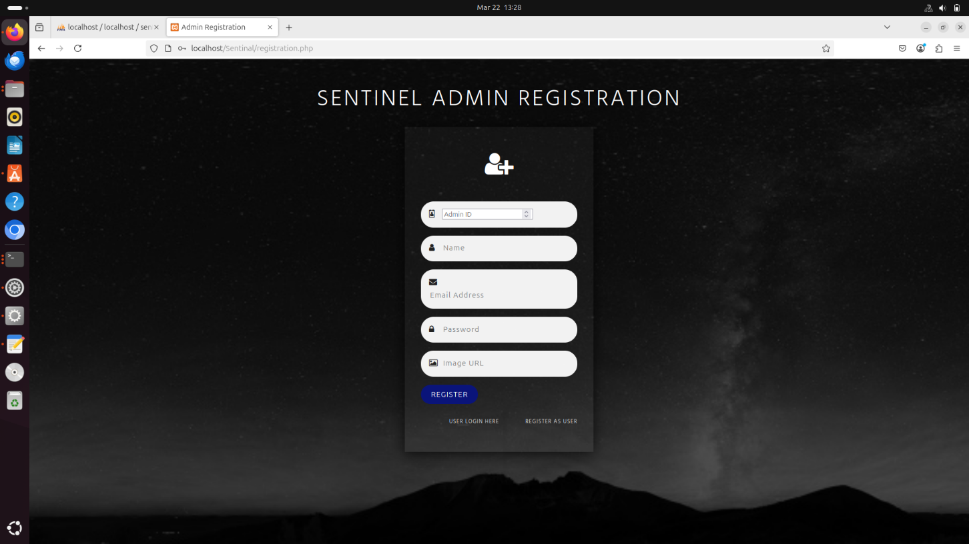
Admin registration page

Slide 11
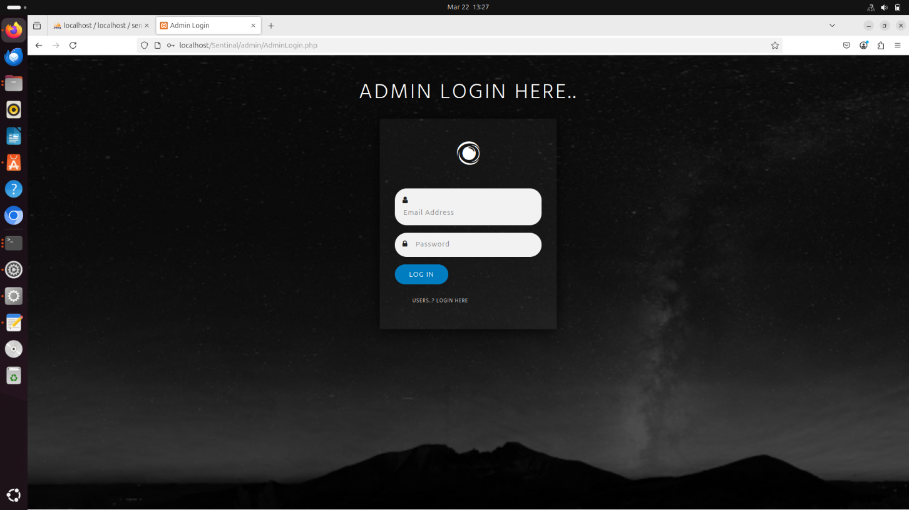
Admin login page

Slide 12
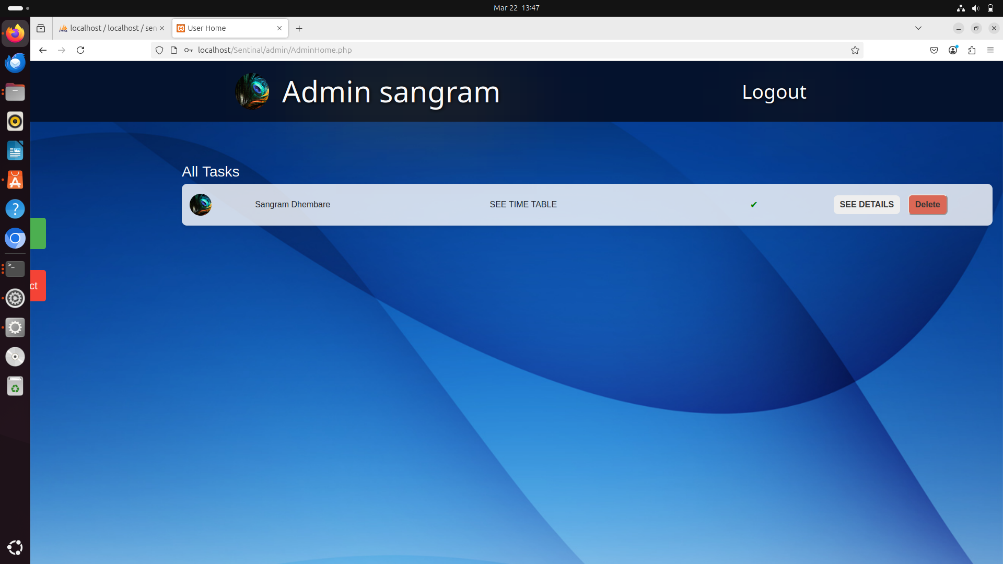
ADMIN HOME PAGE

Slide 13
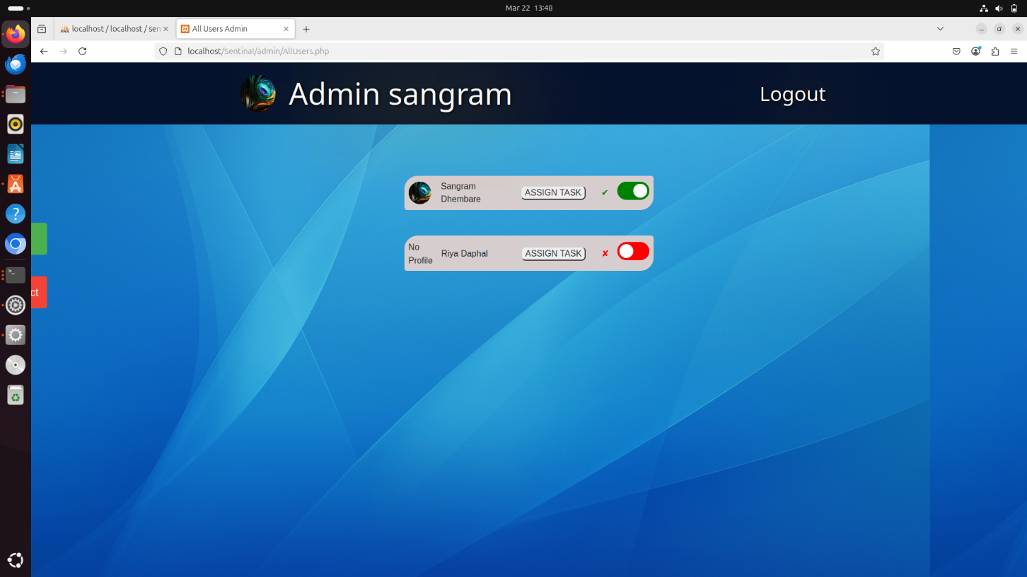
ADMIN ALL USERS

Slide 14
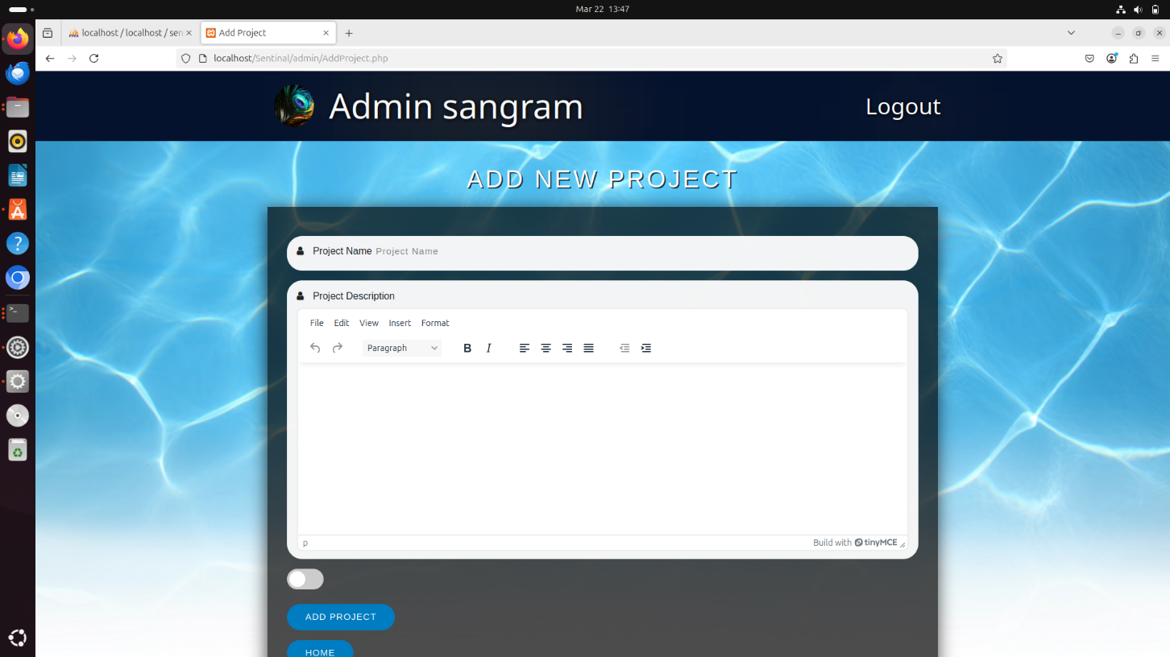
ADD NEW PROJECT

Slide 15
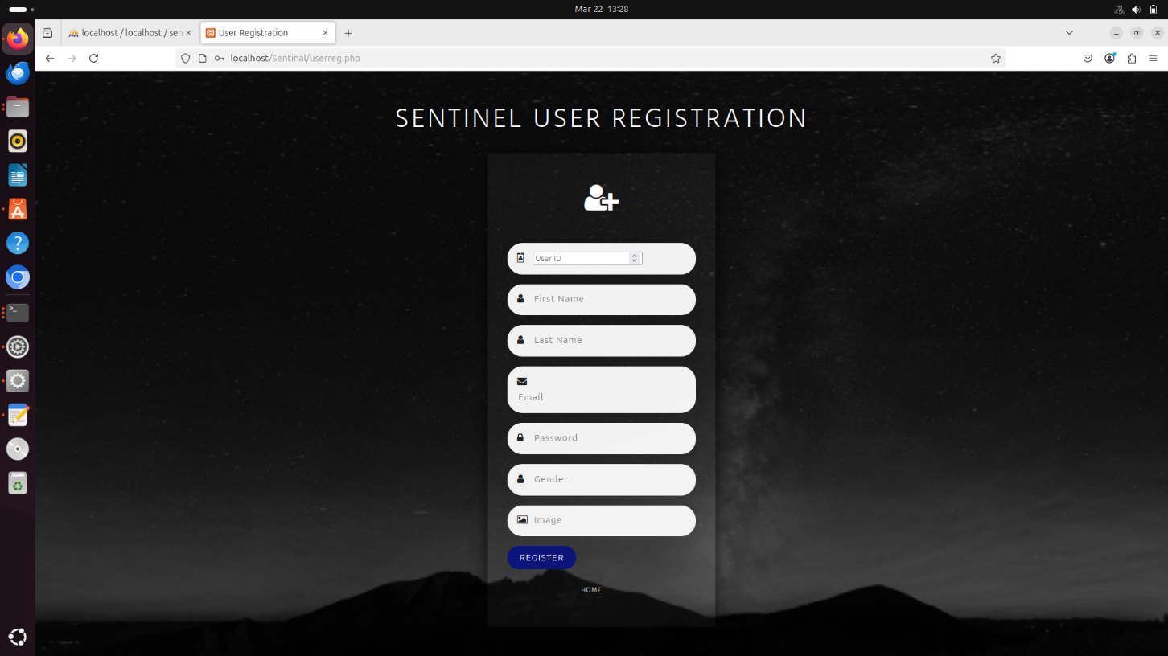
user registration page

Slide 16
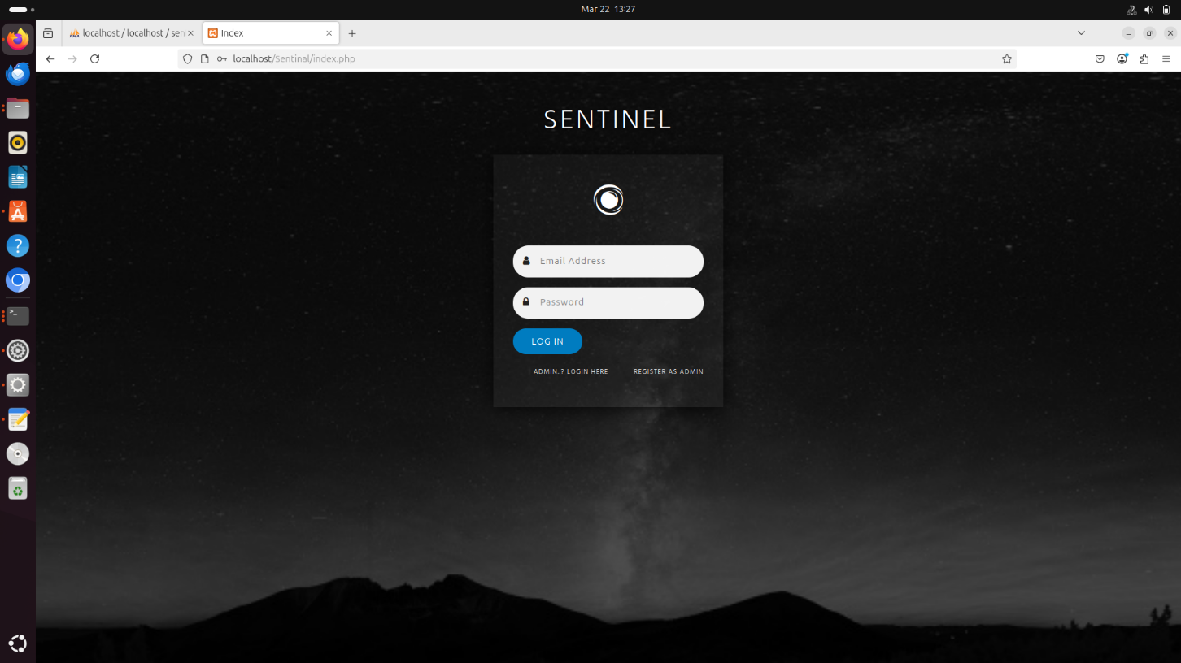
user login page

Slide 17
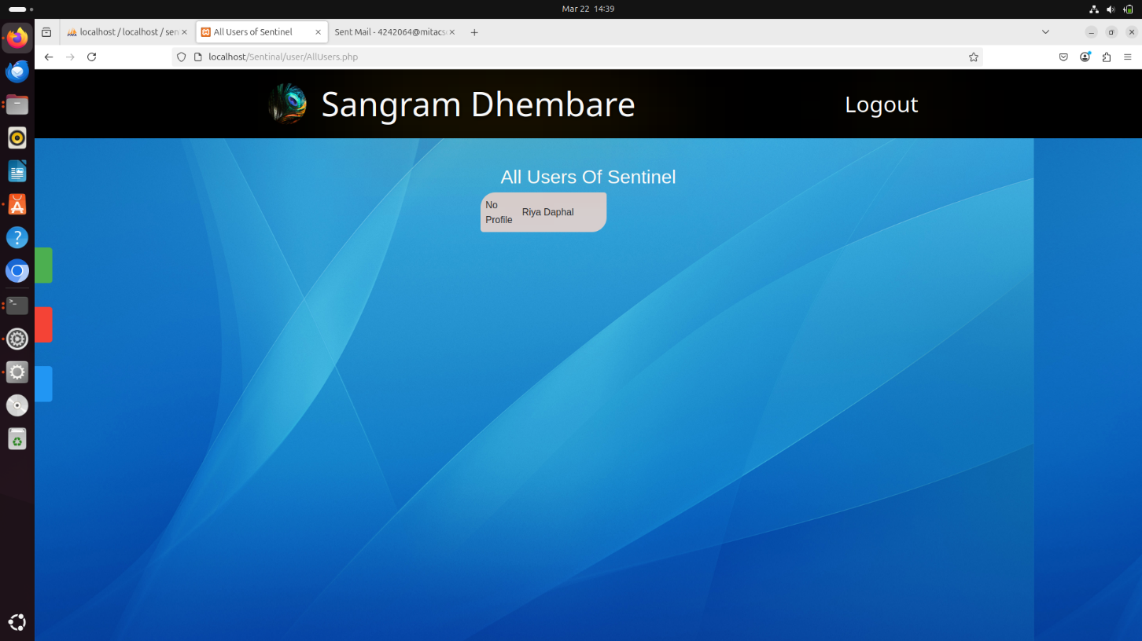
OTHER USER LIST

Slide 18
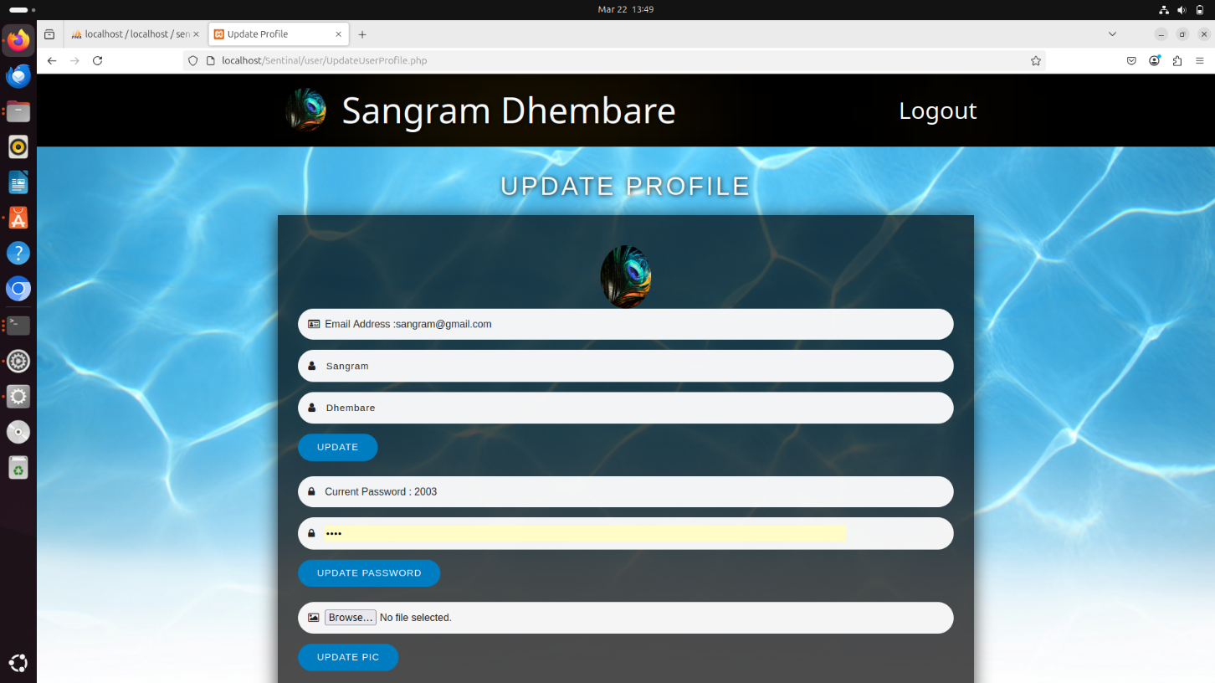
UPDATE USER PROFILE

Slide 19
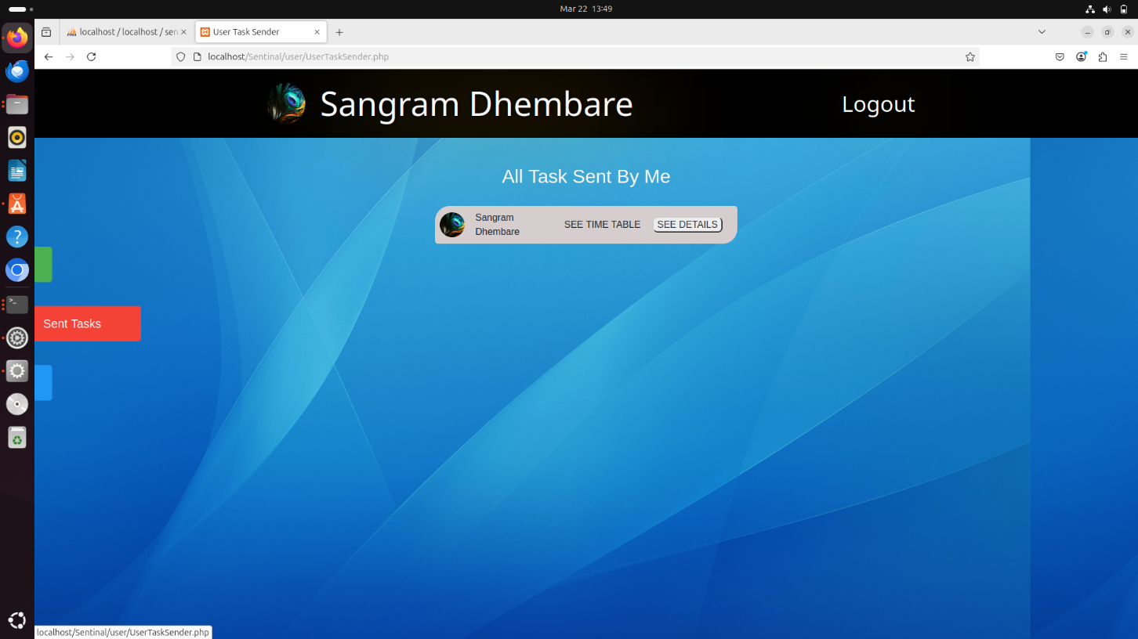
SENT TASK

Slide 20
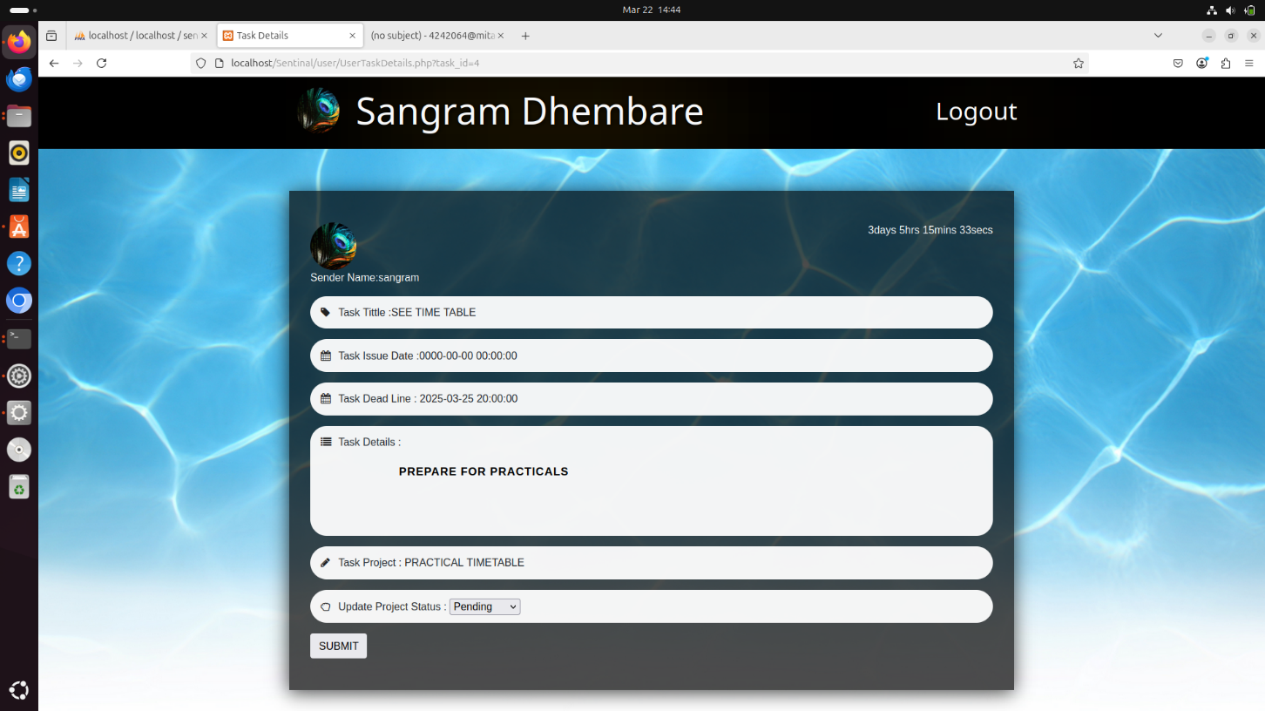
TASK UPDATE

Slide 21
SOFTware Requirements
Operating System:
Windows: Windows 7 or higher.
Linux: Any modern Linux distribution (e.g., Ubuntu, Fedora).
Web Browser:
Supported Browsers: Google Chrome, Mozilla Firefox, Microsoft Edge, Safari (latest versions recommended).
Database Management System (for self-hosted task management system):
Options: MySQL, PostgreSQL.

Slide 22
Hardware Requirements
Computer or Mobile Device:
CPU: A modern processor (e.g., Intel Core i3 or higher, AMD Ryzen 3 or higher).
RAM: Minimum of 2 GB (8GB or more recommended for better performance).
Storage: At least 500MB of free disk space for installation and data storage. Additional space may be required based on usage.
Display: Screen resolution of 1280x720 or higher for better visibility and user experience.
Internet Connection: A stable internet connection is required for cloud-based task management systems.

Slide 23
THANK YOU
NAME: RIYA DAPHAL & SANGRAM DHEMBARE
ROLL NO: TI3311 & TI3301
EXAM NO: 6041 & 5940

